Slide 1
第五讲、各种I/O接口模块
牛金海

Slide 2
主要内容
1、概述
2、各寄存器的配置
3、实例

Slide 3
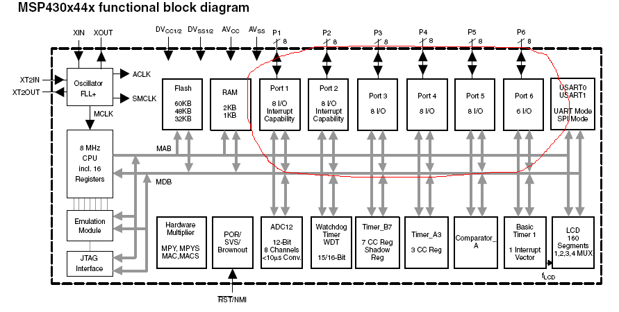
一、概述：I/O在芯片中所处的位置

Slide 4
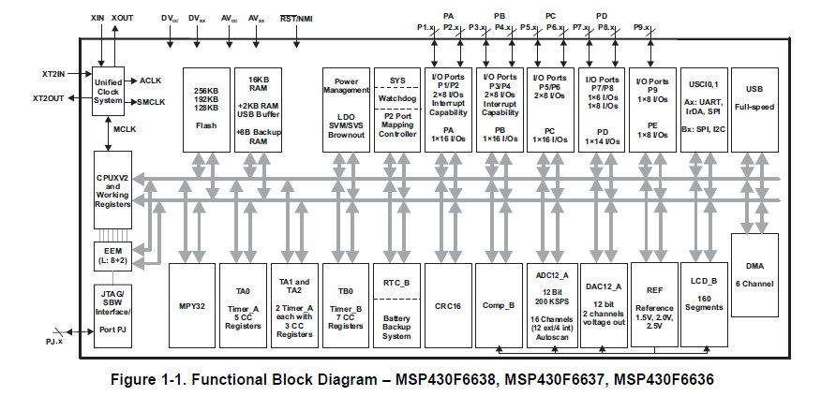
MSP430F6638的I/O口
MSP430F6638有9个IO， MCS51 有几个？

Slide 5
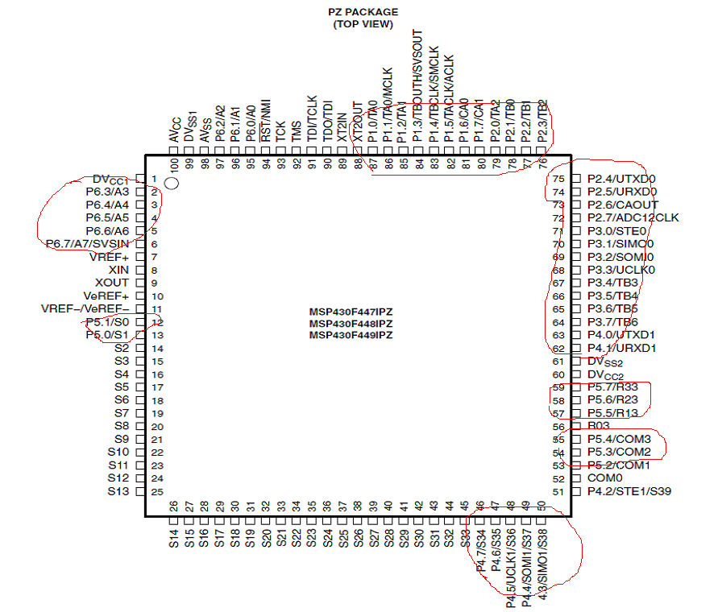
管脚示意图
Notes:
端口复用

Slide 6
二、配置I/O
Every I/O pin is individually configurable for input or output direction, and each I/O line can be individually read from or written to.
可以独立地配置为输入或者输出；
其中P1，P2 可以配置为中断管脚

Slide 7
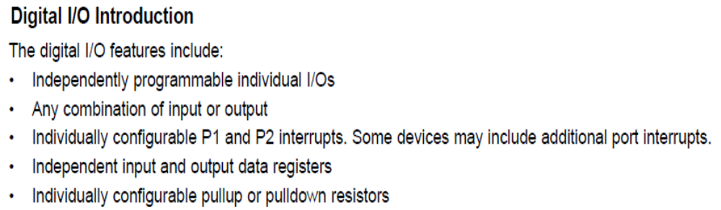
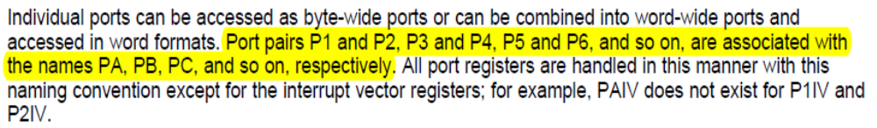
数字I/O的介绍

Slide 8
1、输入寄存器
1 、Input Register PxIN
Each bit in each PxIN register reflects the value of the input signal at the corresponding I/O pin when the pin is configured as I/O function.
Bit = 0: The input is low
Bit = 1: The input is high
只读寄存器，反映I/O管脚上的状态

Slide 9
2、输出寄存器
2 、Output Registers PxOUT
Each bit in each PxOUT register is the value to be output on the corresponding
I/O pin when the pin is configured as I/O function and output direction.
Bit = 0: The output is low
Bit = 1: The output is high

Slide 10
3、方向寄存器
3 、Direction Registers PxDIR
Each bit in each PxDIR register selects the direction of the corresponding I/O pin, regardless of the selected function for the pin. PxDIR bits for I/O pins that are selected for other module functions must be set as required by the other function.
Bit = 0: The port pin is switched to input direction
Bit = 1: The port pin is switched to output direction

Slide 11
4、I/O 模式还是外设模式
4、 Function Select Registers PxSEL
Port pins are often multiplexed with other peripheral module functions. See the device-specific data sheet to determine pin functions. Each PxSEL bit is used to select the pin function — I/O port or peripheral module function.
Bit = 0: I/O function is selected for the pin
Bit = 1: Peripheral module function is selected for the pin
Setting PxSELx = 1 does not automatically set the pin direction. Other peripheral module functions may require the PxDIRx bits to be configured according to the direction needed for the module function. See the pin schematics in the device-specific data sheet.
Notes:
模式切换，也是由某一个特定的BIT位决定的

Slide 12
实例
Output ACLK on P1.5 on MSP430F41x
BIS.B #020h,&P1SEL ; Select ACLK function for pin
BIS.B #020h,&P1DIR ; Set direction to output *Required*
Notes:
BIS.B #020h,&P1SEL
把一个立即数写到P1SEL寄存器中
所谓立即数是和程序绑定的，即读入程序时同时读入立即数

Slide 13
5、P1、P2的中断选择
5、 P1 and P2 Interrupts
Each pin in ports P1 and P2 have interrupt capability, configured with the PxIFG, PxIE, and PxIES registers. All P1 pins source a single interrupt vector, and all P2 pins source a different single interrupt vector. The PxIFG register can be tested to determine the source of a P1 or P2 interrupt.
Notes:
中断的概念 中断服务程序
没有中断之前，只能通过查询方式去和外设沟通，即相当于轮询端口确定某些事情的发生
中断标志位，有没有发生中断事件
中断使能，有没有打开中断
中断方式
所谓All P1 pins共享一个中断向量，就是同一个端口产生的中断都对应同一个中断服务程序
至于到底是哪一个管脚产生的，通过中断标志位来决定IFG

Slide 14
6、中断标志寄存器
Interrupt Flag Registers P1IFG, P2IFG
Each PxIFGx bit is the interrupt flag for its corresponding I/O pin and is set
when the selected input signal edge occurs at the pin. All PxIFGx interrupt
flags request an interrupt when their corresponding PxIE bit and the GIE bit
are set. Each PxIFG flag must be reset with software. Software can also set
each PxIFG flag, providing a way to generate a software-initiated interrupt.
Bit = 0: No interrupt is pending
Bit = 1: An interrupt is pending
Only transitions, not static levels, cause interrupts. If any PxIFGx flag becomes set during a Px interrupt service routine or is set after the RETI instruction of a Px interrupt service routine is executed, the set PxIFGx flag generates another interrupt. This ensures that each transition is acknowledged.
Notes:
IFG中断标志位
进入中断服务程序后，430编程要立刻把IFG清零。不过有些芯片是硬件自动清零

Slide 15
7、中断使能寄存器
Interrupt Enable P1IE, P2IE
Each PxIE bit enables the associated PxIFG interrupt flag.
Bit = 0: The interrupt is disabled
Bit = 1: The interrupt is enabled
Notes:
开关作用，决定中断是否开启

Slide 16
8、中断信号边沿选择寄存器
Interrupt Edge Select Registers P1IES, P2IES
Each PxIES bit selects the interrupt edge for the corresponding I/O pin.
Bit = 0: The PxIFGx flag is set with a low-to-high transition
Bit = 1: The PxIFGx flag is set with a high-to-low transition

Slide 17
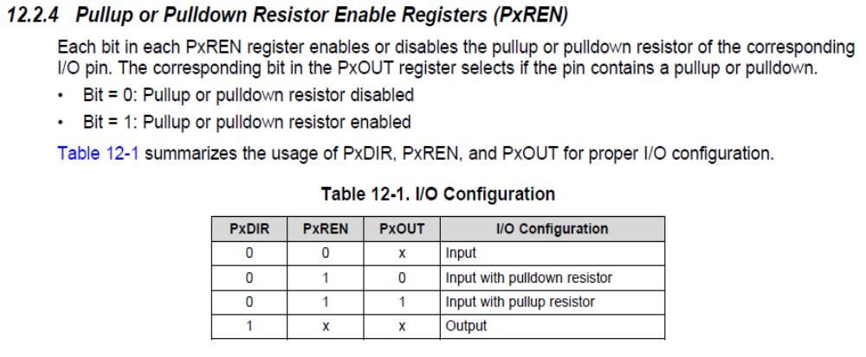
9、上拉/下拉电阻使能寄存器
IO口方向配置为输入模式（PxDIR=0）
上拉就是将不确定的信号通过一个电阻嵌位在高电平,电阻同时起限流作用,下拉使信号固定到低电平上
Notes:
上拉电阻用于当输入端无确定电平（开路）时，将输入确定到逻辑1上，否则这个悬空的输入端，可能由于干扰之类的，被拉到逻辑0。
PxDIR是方向标志位，决定该管脚是输入还是输出
PxREN是使能标志位，在1下才能有所谓的上拉/下拉
PxOUT决定是上拉还是下拉

Slide 18
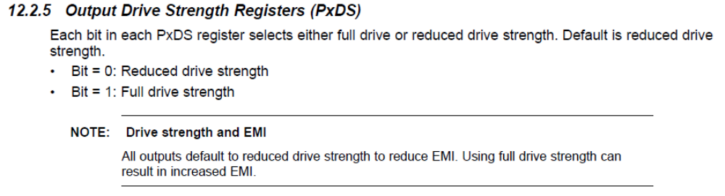
10、输出驱动强度配置寄存器
I/O口上的驱动能力可以配置为低强度或者高强度。 为什么这样做呢？ 不同模式下有什么特点？
Notes:
低驱动强度：功耗低，驱动能力弱，对外的电磁干扰小；
高驱动强度：驱动能力强，功耗大，对外电磁干扰大；
驱动能力的配置是为了节省功耗
驱动的高低是电流的强弱

Slide 19
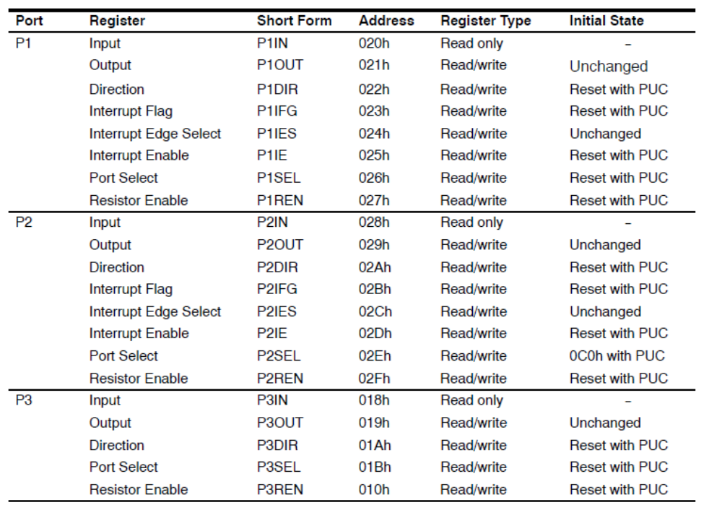
11、寄存器列表
Notes:
这里的Address是偏移量，要加上基地址才是真正的绝对地址

Slide 20
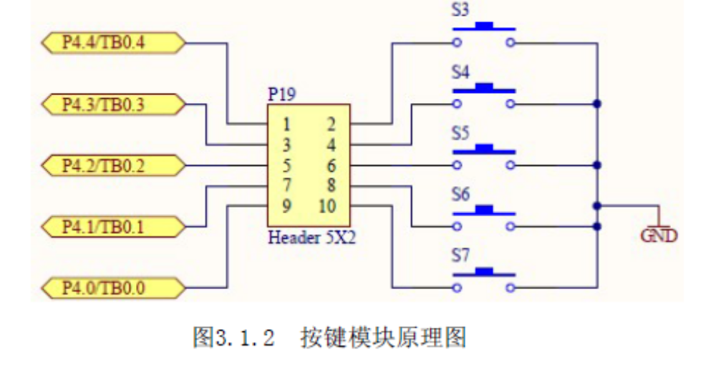
三、实验LAB1的硬件连接

Slide 21
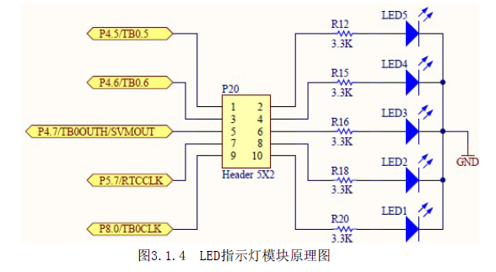
IO驱动LED的硬件接口

Slide 22
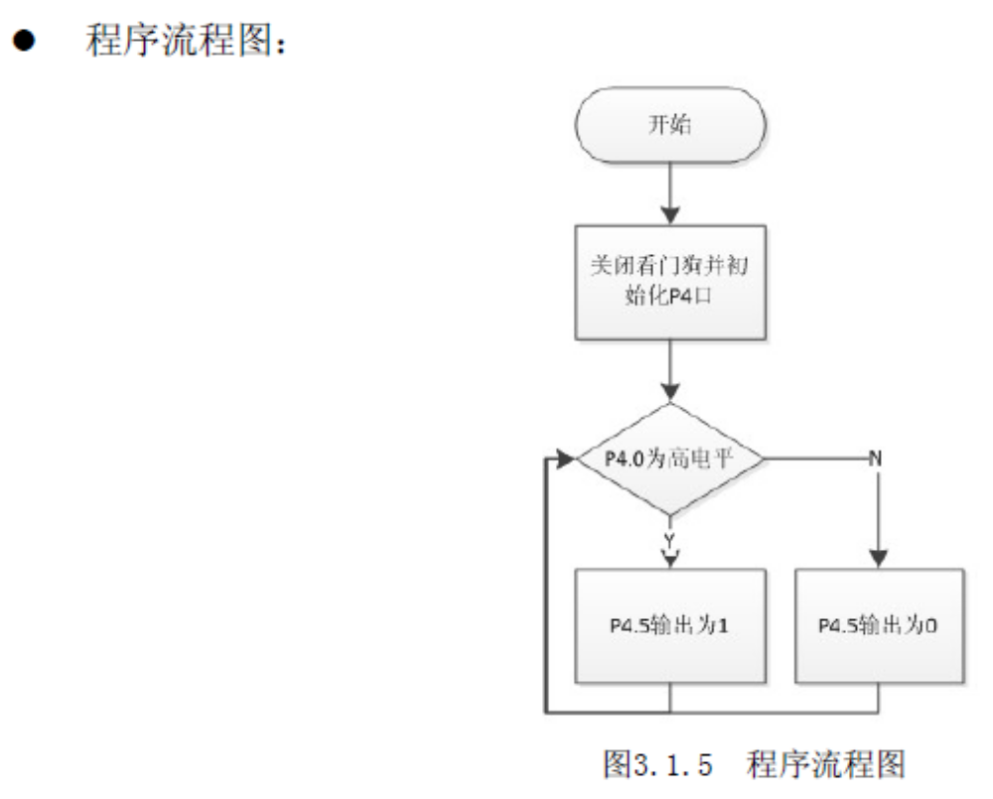
代码

Slide 23
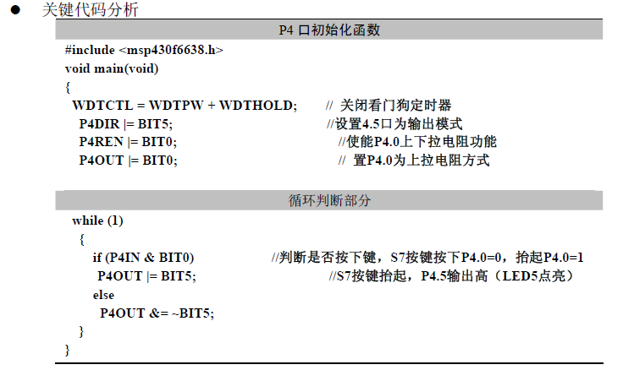
三、实例：LAB1

Slide 24
本章小结
1、比较MSP430 的IO与8051 I/O的异同
2、完全读懂LAB1的C代码以及接口技术
3、掌握MSP430 I/O的原理与使用。

